Slide 1

WIT HACKATHON
WOMEN CO[vi]DE WARRIORS
TEAM NAME
QUENTIN QUARANTINO
From
Pondicherry Engineering College

Slide 2



Slide 3
PROBLEM STATEMENT
To create an online marketing platform to connect consumers with local sellers in order to fight against the impact of COVID-19 pandemic.
SOLUTION : ANGADI
Angadi is a Puducherry Neighbourhood Marketplace.
Online marketing platform to connect consumers with local sellers.
A website www.angadi.co.in is created for the digital enablement of shops, pharmacy, farmers, services and self help groups.

Slide 4
FEATURES
Connecting local stores, pharmacy, farmers, services and self help groups
Creating part time or hourly basis jobs for delivery persons
Multi lingual website accessibility
Scheduled pickup for orders
Map to delivery network
Telegram Integration

Slide 5
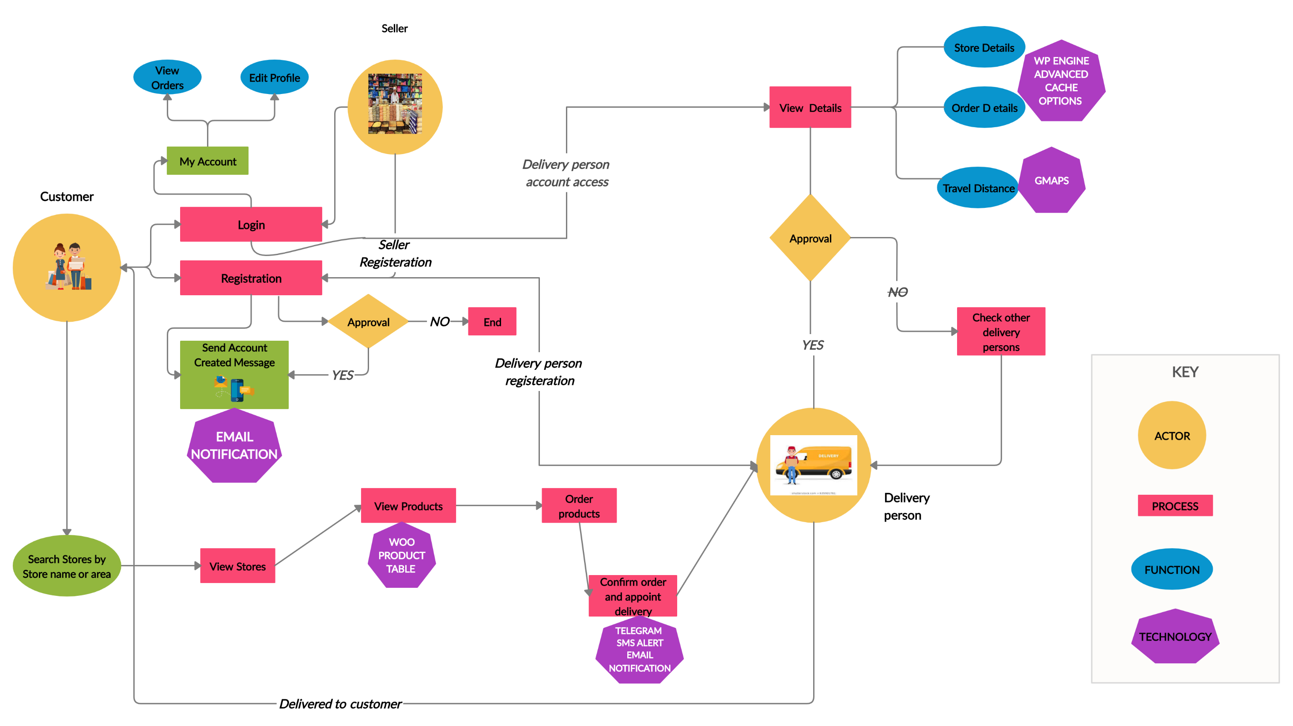
ARCHITECTURE

Slide 6









TECHNOLOGY STACK
Breadcrumb - By PickPlugins
Delivery Drivers for WooCommerce - By Devio Digital
Duplicate Page - By mndpsingh287
Elementor - By Elementor.com
Elementor Pro - By Elementor.com
GTranslate - By Translate AI Multilingual Solutions
Jetpack by WordPress.com - By Automattic
Martfury Addons - By DrFuri
Meta Box - By MetaBox.io
Permalink Manager Lite - By Maciej Bis
Popup Builder - By Sygnoos
PPOM for WooCommerce by N-MEDIA - By Najeeb Ahmad
reCaptcha by BestWebSoft - By BestWebSoft
Single Store Order - By Angadi
Site Kit by Google - By Google
SMSAlert – WooCommerce - By Cozy Vision Technologies Pvt. Ltd
Tamil Thirukural - By Hareesh Pillai
Telegram order confirmation - By Angadi
WCFM - WooCommerce Frontend Manager - By WC Lovers

Slide 7







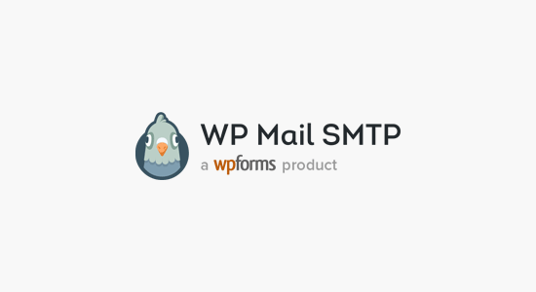
TECHNOLOGY STACK
WCFM - WooCommerce Multivendor Marketplace - By WC Lovers
WCFM - WooCommerce Multivendor Marketplace – Elementor - By WC Lovers
WCFM - WooCommerce Multivendor Membership - By WC Lovers
Widget Menuizer - By Cornershop Creative
Woo Product Table - By CodeAstrology
WooCommerce - By Automattic
WooCommerce added to cart popup (Ajax) - By XootiX
WooCommerce Services - By Automattic
WooCommerce Unit Of Measure - By Bradley Davis
WooCommerce Variation Swatches Pro - By Drfuri
WP Engine Advanced Cache Options - By Ethan Kennedy, Steven Word
WP Mail SMTP - By WPForms
WPBakery Page Builder - By Michael M - WPBakery.com
YITH WooCommerce Compare - By YITH
YITH WooCommerce Wishlist - By YITH
Language used to develop the website is PHP,CSS,LESS. Plugins are developed using PHP. HTML is also used to customize the pages .

Slide 8
SHOW STOPPERS
Time management of Orders
Store Stock Maintenance
Opening/Closing of stores should be mentioned
Price and quality difference between different shops
Lack of live interaction

